Slide 1
Ev go

Slide 2
CONTENTS
OUR TEAM
INTRODUCTION
DFD
PRIMARY GOALS
MODULES
MODULE DISRIPTION
WEBSITE DESIGN
ANDROID DESIGN
AREAS TO IMPROVE
SUMMARY

Slide 3




MEET OUR TEAM
TANSEEHA JABIN
NISHLA SHEMINAS
NIHAL A P
MUNAWAR M T

Slide 4
INTRODUCTION
We are aiming to create an application using which the users can find the charging stations of various companies with the help of GPS. Here a user can view the slots in a station, whether it is free or occupied using the mobile application without going there in person. He can book the slots from the app so that he only need to reach there on the time of his appointment.

Slide 5
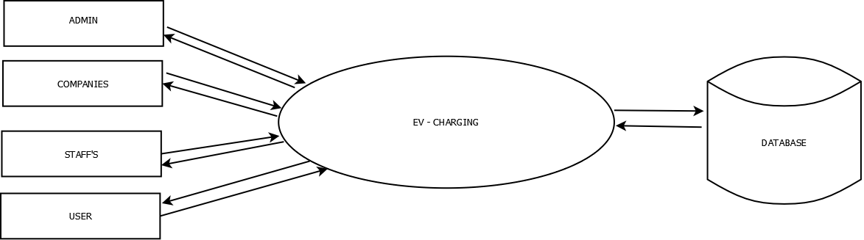
LEVEL 0

Slide 6
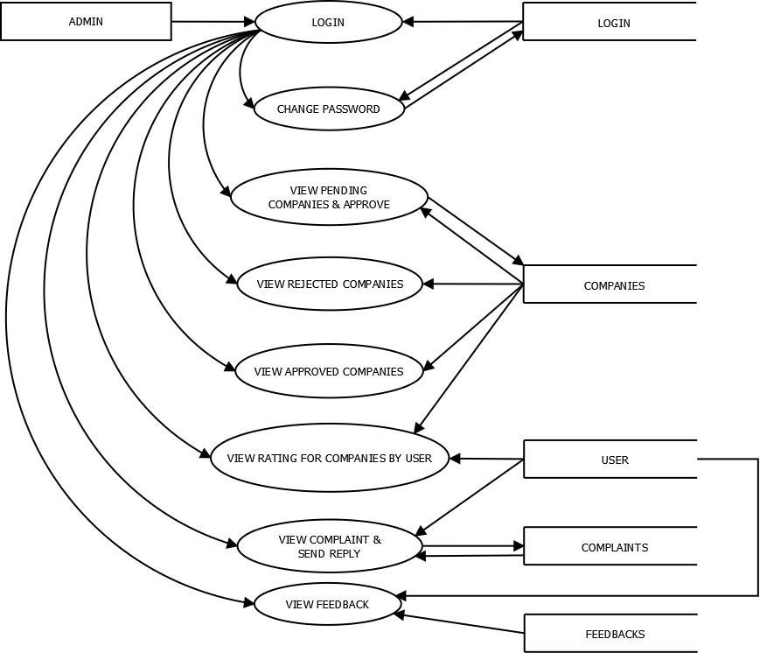
LEVEL 1 FOR ADMIN

Slide 7
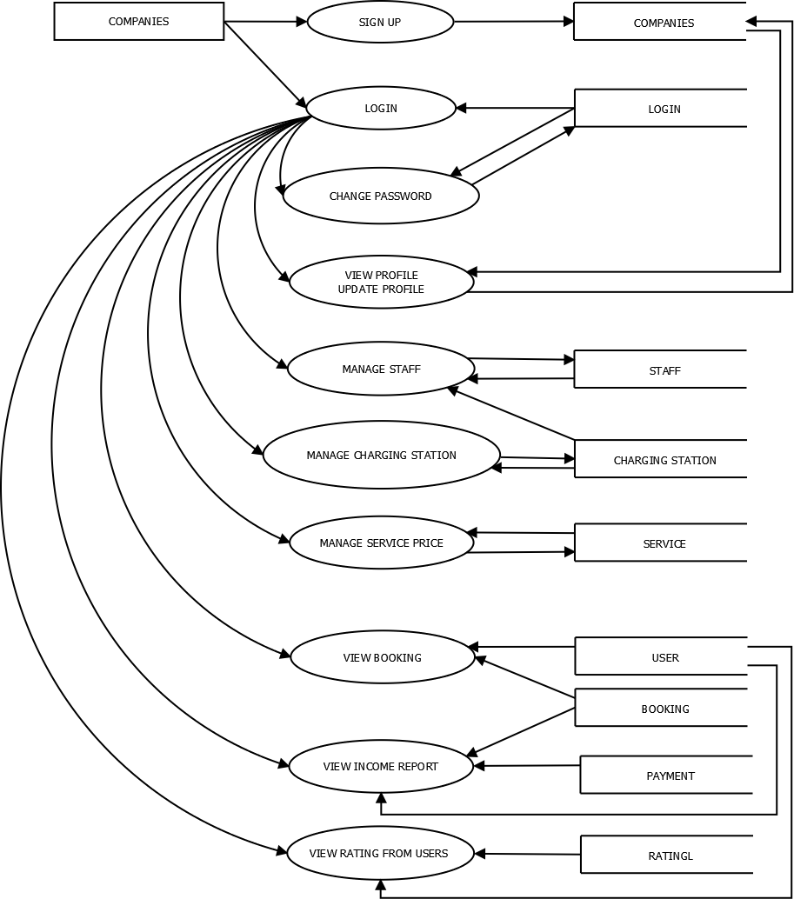
LEVEL 2 FOR COMPANY

Slide 8
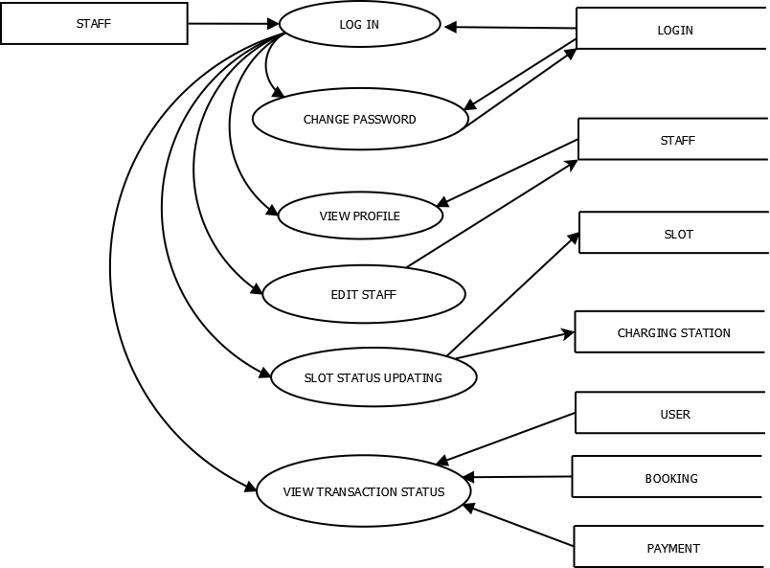
LEVEL 3 FOR STAFF

Slide 9
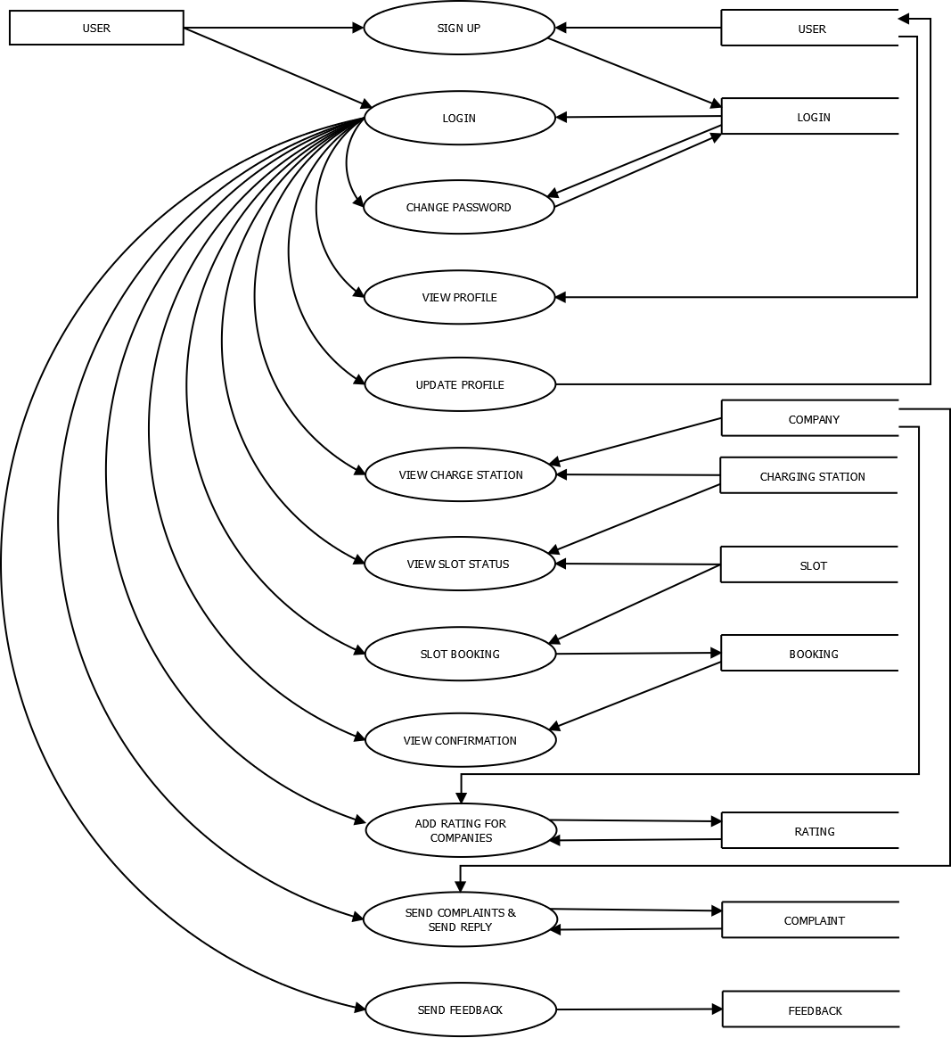
LEVEL 4 FOR USER

Slide 10
PRIMARY GOALS
Every Companies can add their EV charging stations to our system
An EV User can book your charging slot simply using this application
View location of your charging station using EVGO application

Slide 11
Modules
ADMIN
COMPANY
STAFF
USER

Slide 12
MODULE DISCRIPTION
ADMIN
MANAGE THE WHOLE SOFTWARE PRODUCT
GIVE ACCESS TO THE COMPANIES
COMPANY
MANAGE THEIR OWN CHARGING STATIONS
MANAGE STAFF
STAFF
MANAGES THE WHOLE BOOKING SYSTEM
MANAGE THE SLOT SYTEM
PRIMARY CLIENT OF THE PRODUCT
USE APPLICATION FOR SLOT BOOKING
USER

Slide 13
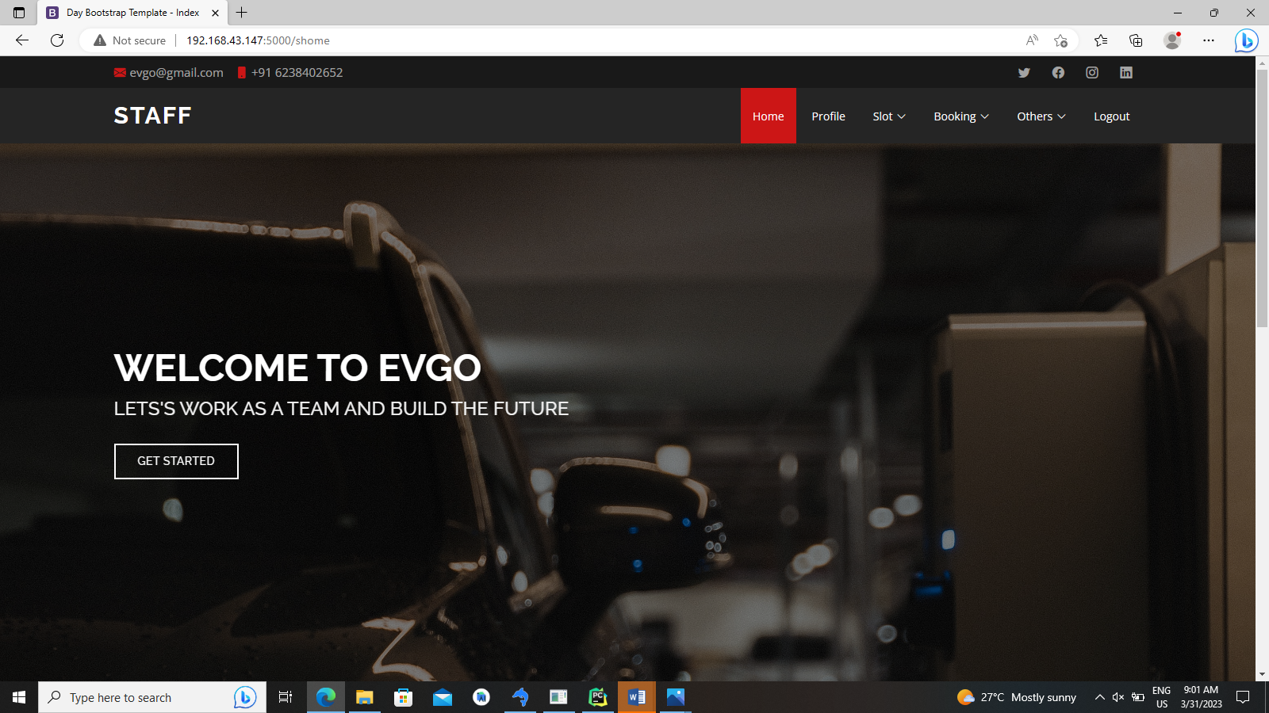
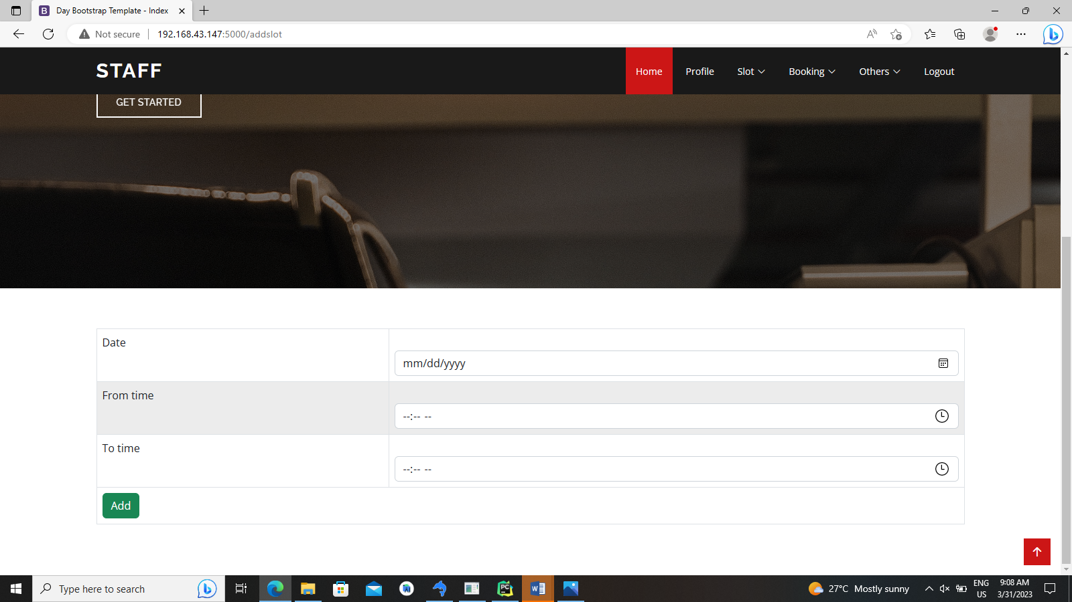
WEBSITE DESIGN
Q1
Q2
Q3
Q4

Slide 14
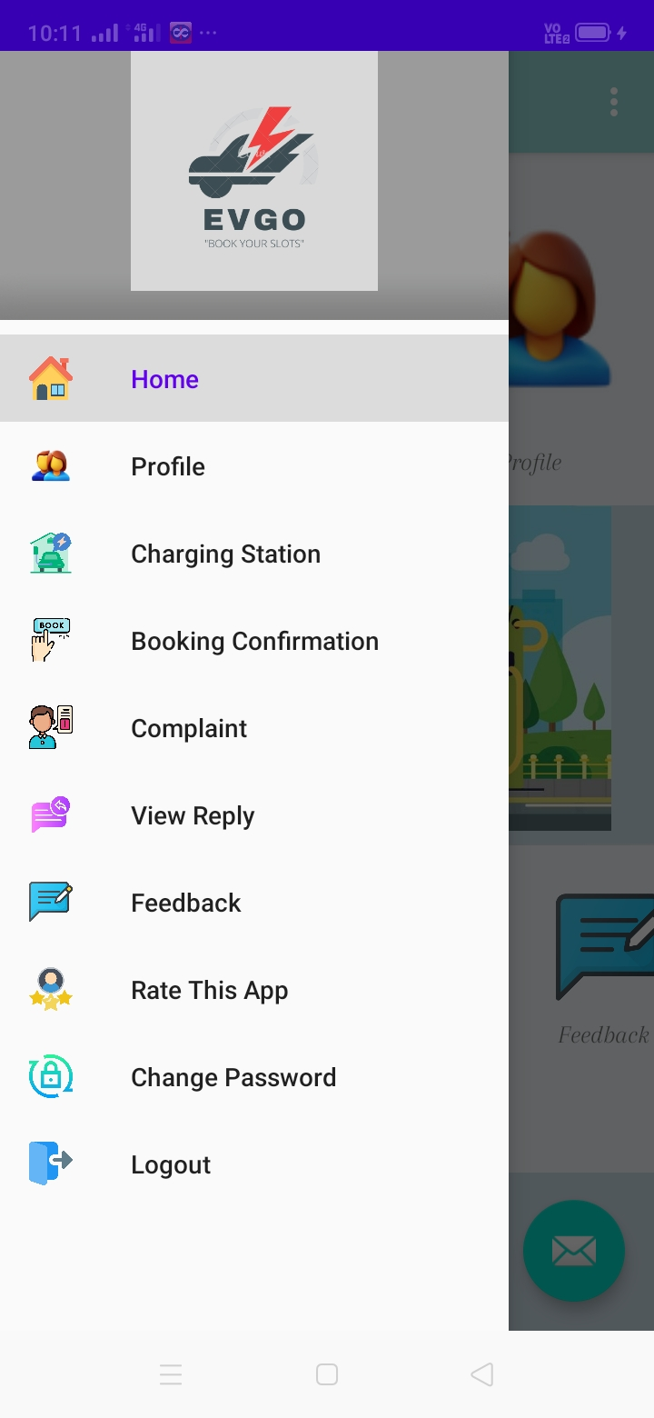
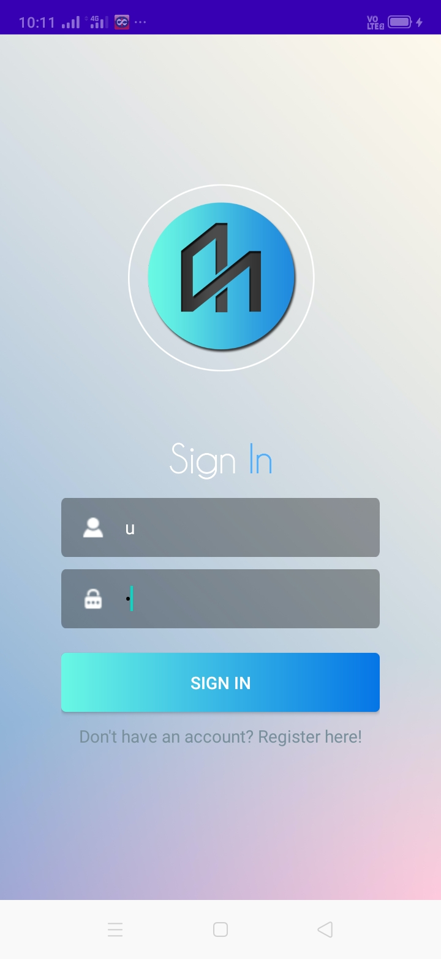
APPLICATION DESIGN
Q1
Q2
Q3
Q4

Slide 15
AREAS TO IMPROVE
PAYMENT WALLETS
CHAT SUPPORT
DYNAMIC PRICING

Slide 16
SUMMARY
In conclusion, an EVGO slot booking app is an excellent solution for managing the charging process of electric vehicles. It allows EV drivers to reserve a charging slot at their convenience, thus eliminating the need to wait in long queues or drive around in search of an available charging station.

Slide 17
THANK YOU

